Slide 1
Trends in Communications
By: Kaitlin Armstrong

Slide 2
What is Community Relations?
Relationship between the company.
Part of a team’s marketing plan.
Incorporates people who live in the area.

Slide 3
Incorporating Social Media
Building a fan base
Live-tweeting, fan giveaways, posting highlight reels
Team hashtags: #InBrotherhood (ATL)
Financial investment

Slide 4
Using Players
Lynn Athletics
Prioritizing star athletes in sports franchises.
Must be a positive representation of the team.

Slide 5
Atlanta Falcons Community Relations
My experiences with the Falcons.

Slide 6
Charity Work
Children’s Hospital
Engaging the team

Slide 7
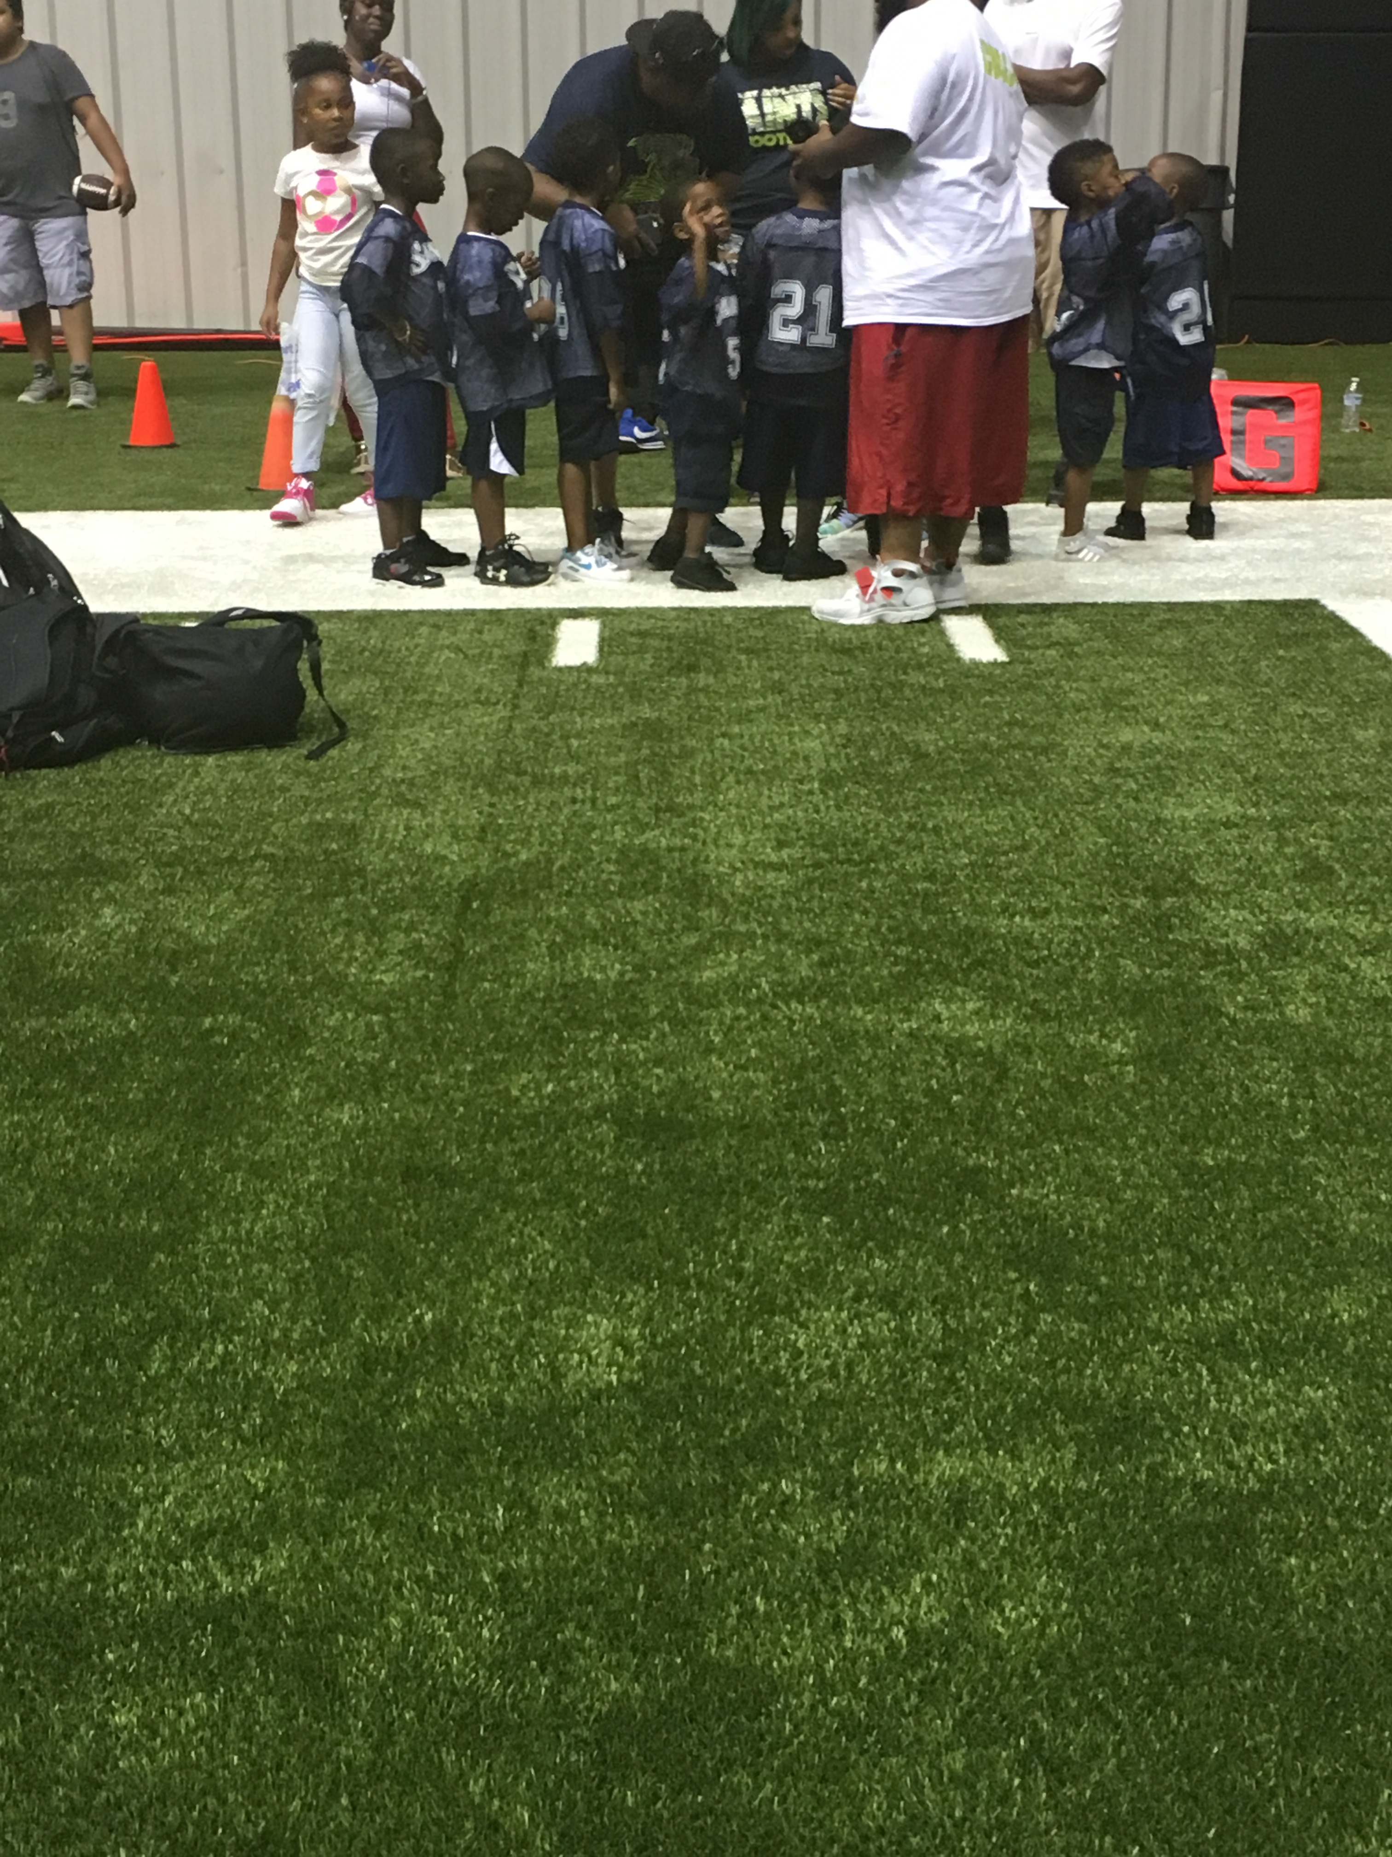
Youth Football Teams
Middle & High school teams invited to training facility.
Allows kids to see a future with football.
Shows the community ATL Falcons care about the future of the sport.

Slide 8
Everyday Activities
Fan activities at training camp
Playbooks for fans
Free food and beverages
Interactive stations for fans (photo).
Volunteers everyday

Slide 9
Conclusion
Getting the community involved
Social media
Events that are hosted

Slide 10
References
Clapp, B. (2017, January 31). Unique Strategies For Using Social Media in Sports Marketing. Retrieved from https://www.workinsports.com/blog/unique-strategies-for-using-social-media-in-sports-marketing/

